Slide 1



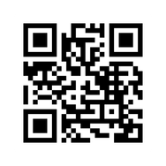








Arthoven is a new cozy art studio located in Woensel XL shopping center in Eindhoven. We organize art workshops for both children and adults in different languages, bringing people together through art.
We invite everyone to join our regular activities such as:
  Sketch Wednesday
  Collage Friday Lab
&
friday
Sketch Wednesday
Lab
We are also currently enrolling participants for our watercolor painting courses.
Botanical Watercolor on Tuesdays or Wednesdays
ARTHOVEN.NL
In addition, we offer many workshops in different art techniques. You can find the full program on ARTHOVEN.NL — and we warmly invite you to come and experiment creatively with us.
We would be very grateful for your informational support through the ASML Next newsletter.
Arthoven is also open to collaborations with creative people who would like to host their own workshops or events in our space, as well as private creative events with our workshops.

