Slide 1



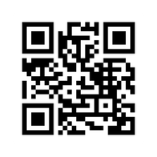
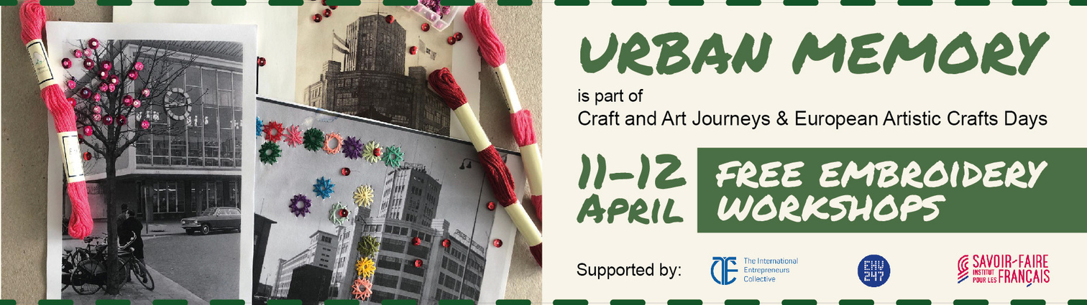






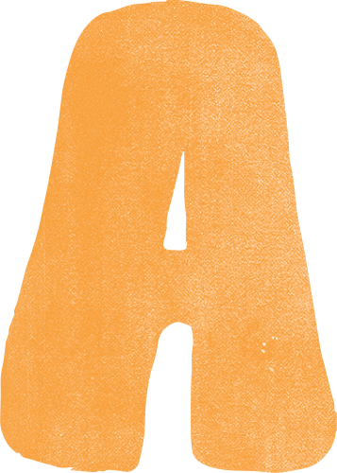


Arthoven is a new cozy art studio located in Woensel XL shopping center in Eindhoven. We organize art workshops for both children and adults in different languages, bringing people together through art.
On April 11–12, as part of the European Artistic Crafts Days, we invite everyone to a free creative event URBAN MEMORY connecting personal stories with the city of Eindhoven. Participants will embroider simple patterns on black-and-white photos of the city, creating a small artwork that combines memory, place, and imagination.
We also welcome everyone to our regular activities such as
  Sketch Wednesday
  Collage Friday Lab
  as well as many other workshops and courses.
We would be very grateful for your informational support through the ASML Next newsletter.
Arthoven is also open to collaborations with creative people who would like to host their own workshops or events in our space, as well as private creative events with our workshops.
Sketch Wednesday
friday
ARTHOVEN.NL
Lab

